Slide 1
End-to-end support for technicians to fix machines faster
September 15, 2026

Slide 2
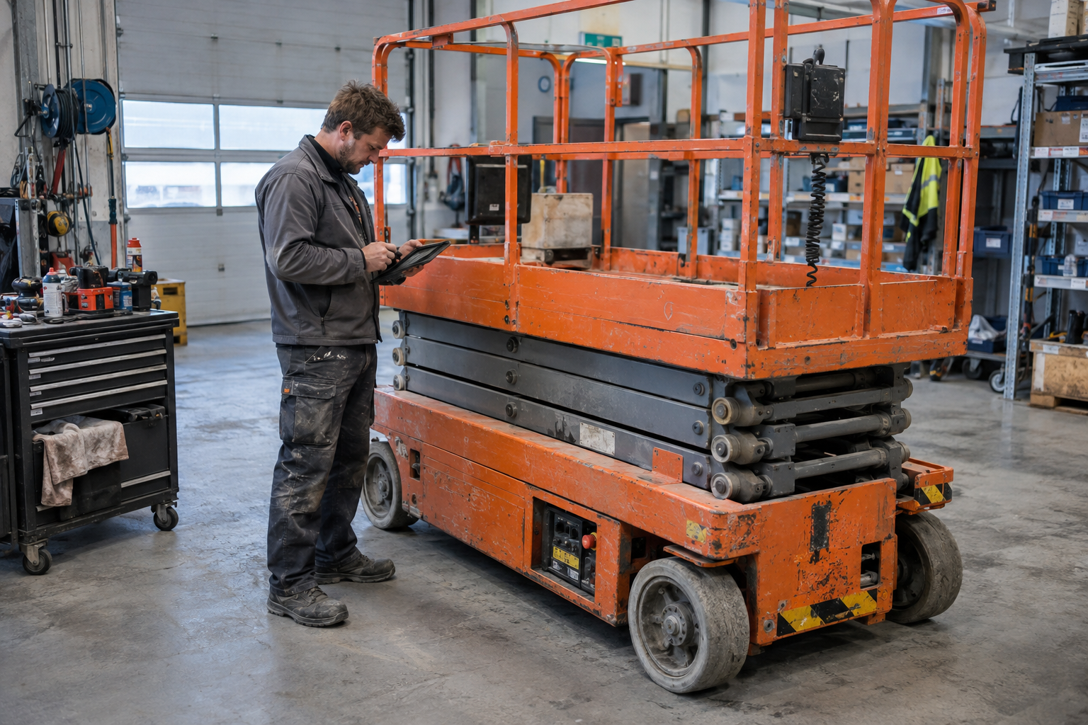
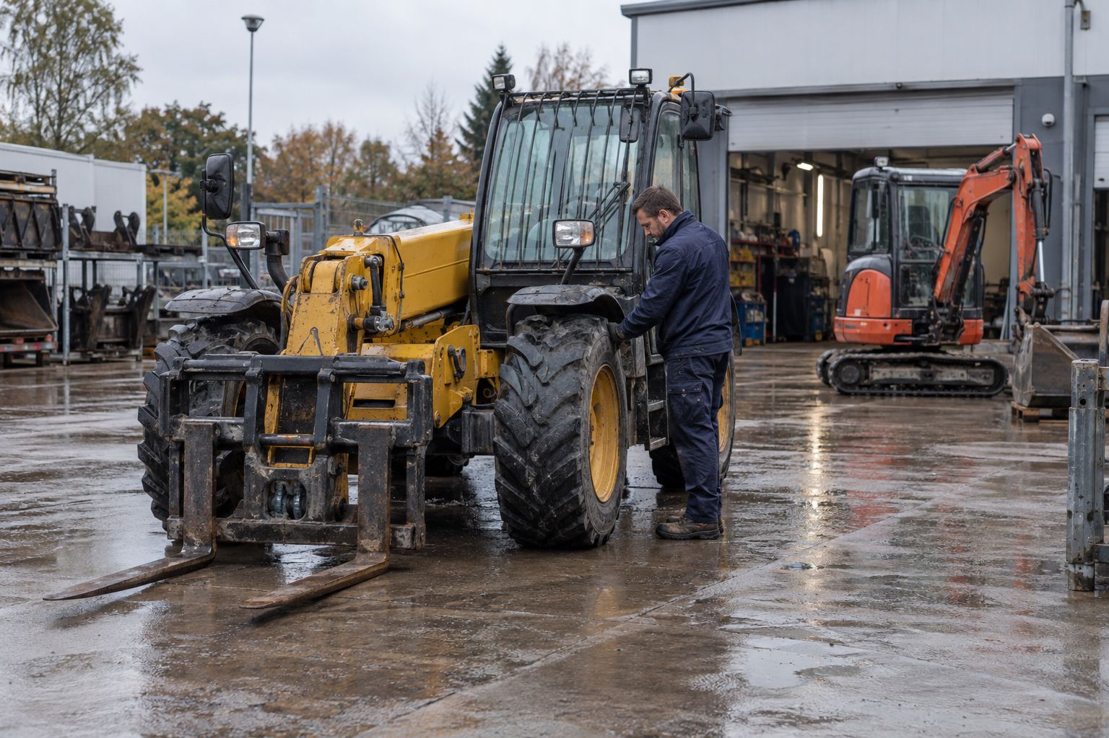
Which one is AI generated?
A
B

Slide 3
Who is already using AI?

Slide 4

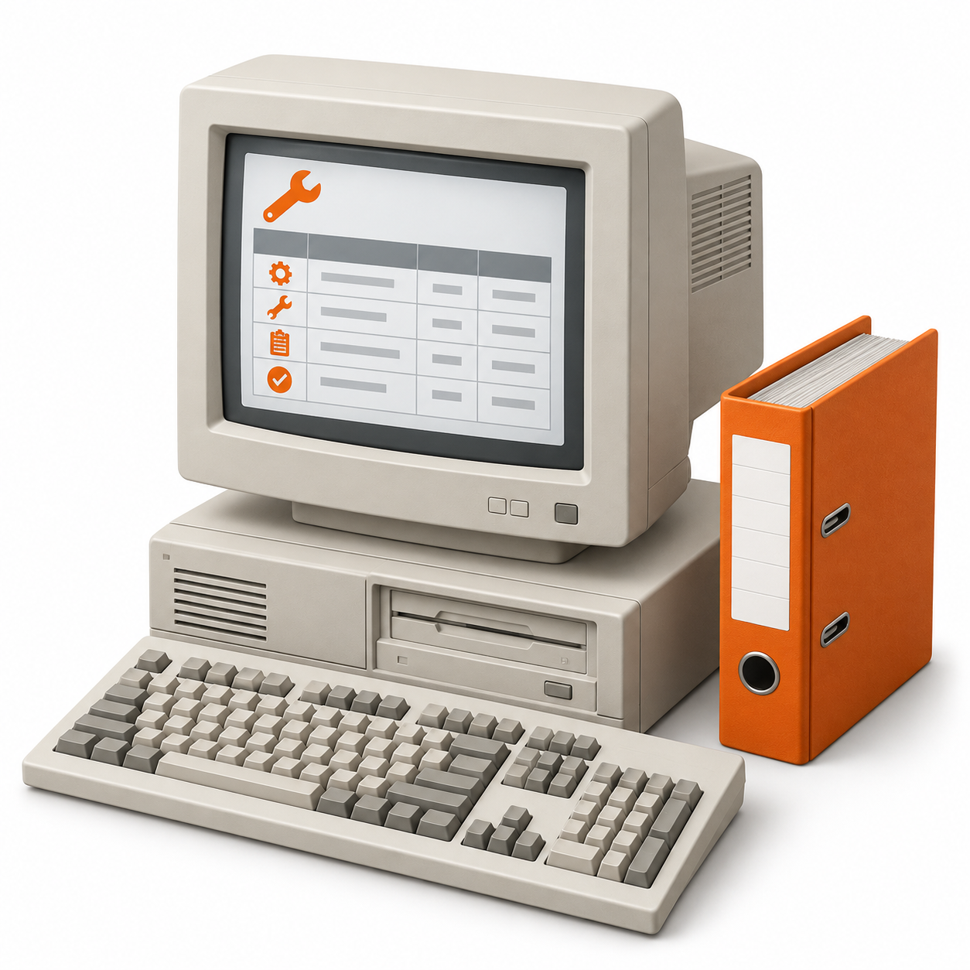

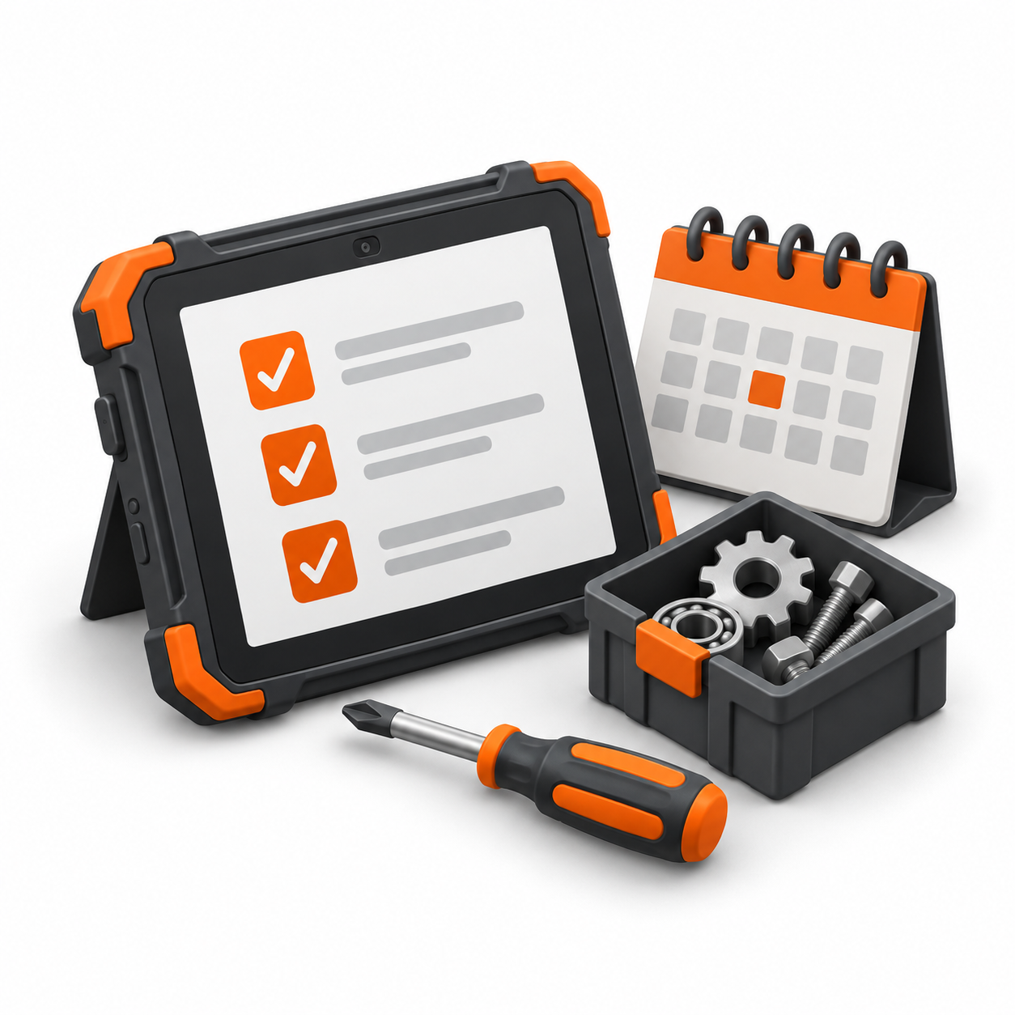
How service technology evolved
Earlier
1980s–90s
2000s–10s
Emerging now
Phone & paper
Digital records
Telematics
AI agents
Call the person
who knows
Manually look up
service history
See location,
hours & alerts
Understand & suggest fixes

Slide 5
What does “agentic” mean?
You give AI a job. It understands the problem and works on it autonomous
1
Look up the machine
“Prepare a
service visit
for this boomlift.”
Read its history, alerts and manuals
2
Prepare the visit
Suggest probable solutions and parts
One job.
Scattered data & systems.
3
Technician in control
AI never does anything without approval

Slide 6
Three challenges for mobile equipment service
01
02
03
Skilled technicians
are hard to find
Machines demand
more expertise
Information is
scattered
A few experts know almost everything, but knowledge is lost when they leave
Experience as bottleneck
Electronics, software
and differences in brand, models and types of machines
Increasingly complex
Manuals, ERP records,
live machine data and
technician experience
All scattered and hard to use in the field

Slide 7
Use cases:
AI to help operational excellence
01
Capture and grow company knowledge and use it to get new technicians up and running fast
02
Every technician gets what they need to troubleshoot, tailored to their level of expertise
03
Close the gap between technicians in the field and the people at the office (e.g., inventory)

Slide 8
3 non-negotiables for AI to be adopted by your after-sales team
it has to be correct
it has to be easy to use
it has to be helpful

Slide 9
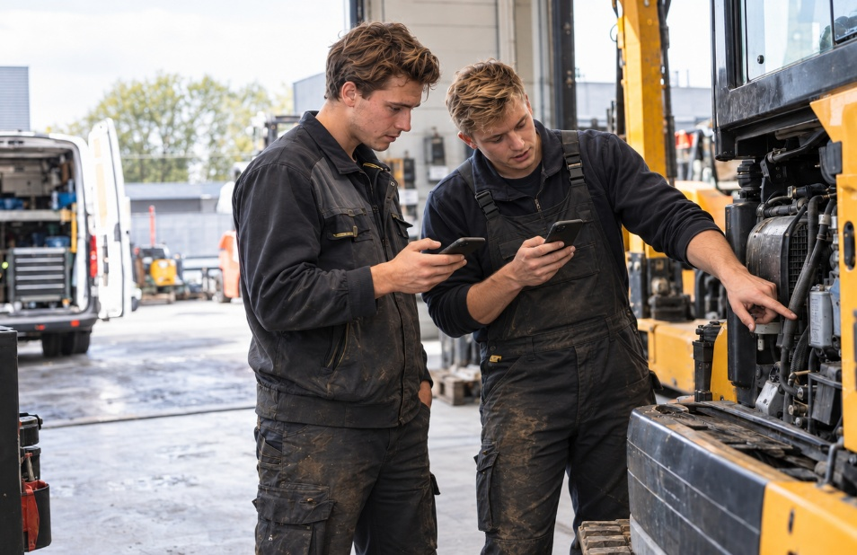
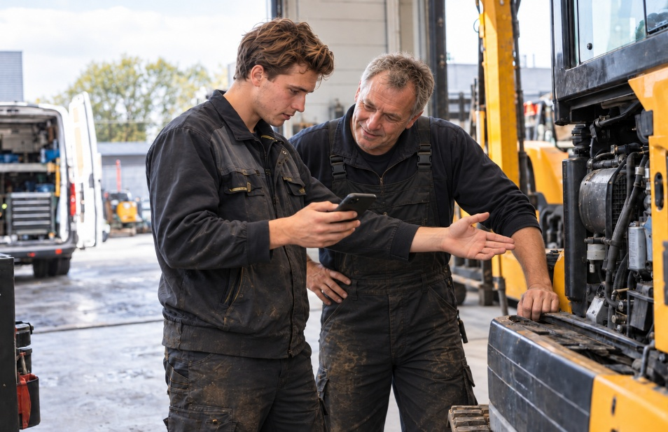
Young technicians can be pioneers!

Slide 10
What are the results of using AI for after-sales?
After sales quality improved
Experience & history secured
Rental company
Future
ready
More efficient

Slide 11
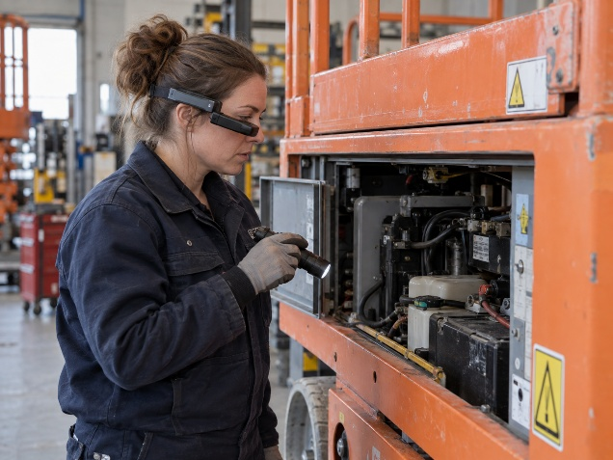
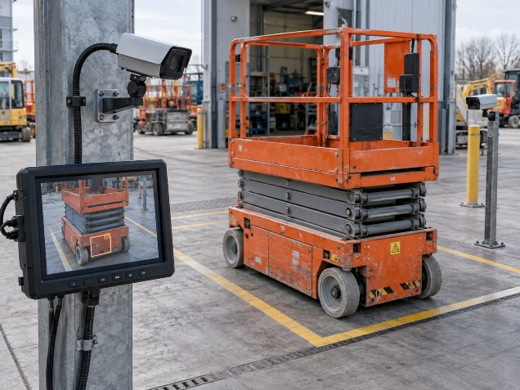
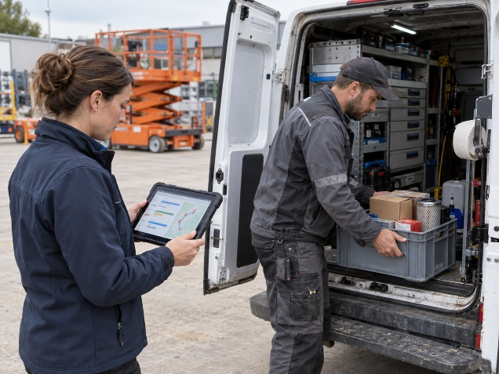
What comes next?
Live guidance
Automatic inspections
Coordinated service

Slide 12

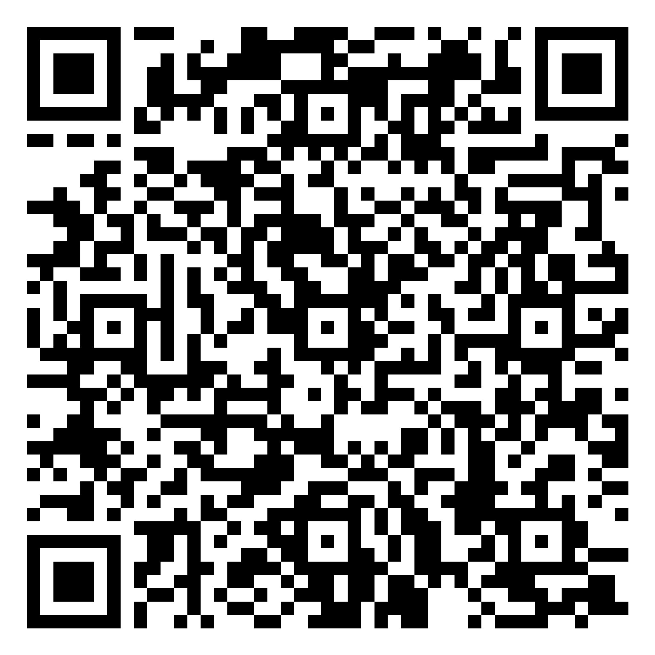



Get started with Sara!
Contact us:
loic@asksara.ai
+32 471 46 95 78
www.asksara.ai
Dok-Noord, 9000 Gent
Book your demo:

